Slide 1

Introduction to Big Data and Streaming Data
Unit 1
Dr. Yousefi

Slide 2

Discussion:
Be
Students will be expected to post their primary Discussion Board posting by Thursday of each week.
Be
Discussion posts will be graded, and late submissions will be assigned a late penalty in accordance with the Late Penalty Policy found in the syllabus.
NOTE
NOTE: All submission posting times are based on midnight Central Time.

Slide 3

IP1
During your first Individual Project (IP), you will setup the Python environment Anaconda that will be used for subsequent IPs.
During this task, the Spyder IDE will be installed, and a simple program will be created to demonstrate that it is working correctly. This link will provide guidance.

Slide 4

IP1--
Once the IDE is installed, research Python data streaming libraries. Identify 1 of interest, and you will utilize it for the Unit 1 activity.
Write the needed Python code based on the Titanic data set that assumes records will be streaming and predictions could be made for survival.
For this activity, we will not be writing the predictions.
Rather, the streaming data architecture will be defined.
Download the Titanic data set

Slide 5

IP1
The project deliverables include the following:
Download the Titanic data set.
Utilize Python and a streaming library of choice to consume the data set.
Provide a screenshot of the ingested data.
Submit your solution for grading in Microsoft Word document.

Slide 6

Live Chat
In this class, you can receive credit for attending Live Chats or reviewing the chat archive. This opportunity is available once per week. To receive these points, you can either:
Attend the Live Chat session. or
Review the archived chat session and submit a 200-word content summary. The archive review summary must meet the expectations described below.

Slide 7

Live Chat
Summarize the content of the chat.
Some ideas for what to include are a description of what information was covered and how you will apply this information to your academic or professional work.
Label the document "Chat Credit" with the date the Live Chat was presented.
A summary must be submitted within 1 week of the Live Chat to be considered for credit.

Slide 8

Demo
View the Individual Project Demo for guidance on how to submit your chat summary as an Individual Project via the Virtual Classroom or the CTU Mobile app.

Slide 9

Anaconda Installation
Anaconda. (2021). Installation. https://docs.anaconda.com/anaconda/install/

Slide 10
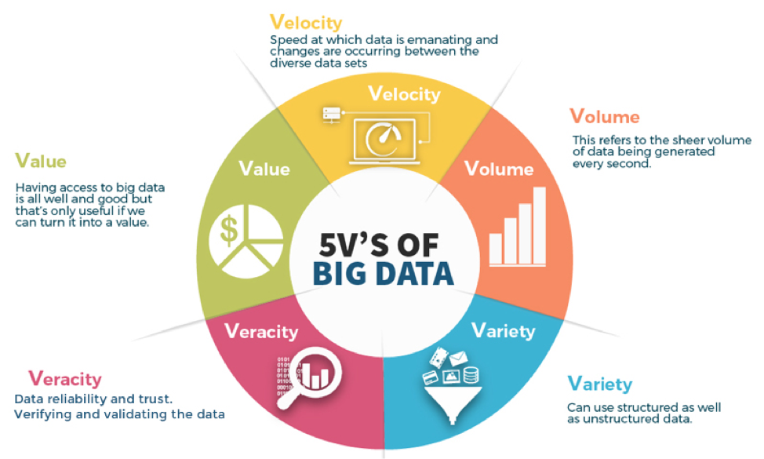
What is Big Data?
Extremely large data sets that may be analyzed computationally to reveal patterns, trends, and associations, especially relating to human behavior and interactions.

Slide 11
What kind of Data is Big Data?
Big data –– or extremely large data sets that may be analyzed computationally to reveal patterns, trends, and associations –– often contain large amounts of:
Structured data
Unstructured data
Semi-Structured

Slide 12

What is Unstructured Data?
Unstructured data is commonly known as “everything else” data. It’s data that has an internal structure but is difficult to search and often is not structured via pre-defined data models or schema.
Unstructured data can be both human-generated or AI-generated; and textual or non-textual.
Big data –– or extremely large data sets that may be analyzed computationally to reveal patterns, trends, and associations –– often contain large amounts of unstructured data such as data relating to human behavior or interactions.

Slide 13

Other common types of unstructured data include:
Human-generated Unstructured Data
Machine-generated Unstructured Data

Slide 14
Structured Data
Structured data, which is typically stored in databases, allows for data to be stored, analyzed, and filtered based on data tag specifications.
Defamation emphasizes that “this format is eminently searchable both with human-generated queries and via algorithms using a type of data and field names, such as alphabetical or numeric, currency or date.”

Slide 15
Semi-Structured Data
Semi-structured data as “data that maintains internal tags and markings that identify separate data elements, which enables information grouping and hierarchies.
Both documents and databases can be semi-structured. This type of data only represents about 5-10% of the structured/semi-structured/unstructured data pie but has critical business usage cases.”
One example of semi-structured data is email. Despite that, you’d need intelligence tools to thoroughly track threads, analyze keywords trends, etc. email provides the capability of searching messages based on content or keywords.

Slide 16
Main Differences
The main difference between these three types of data is their ease of searchability.
Structured data, being stored in a database, provides easy search access to specific data fields, while unstructured data is more difficult to populate, yet it can provide more insight.
Because of this, unstructured data search tools are still in the early development stages.

Slide 17

Main Differences
Say there’s a software database, like a CRM.
Within that database is a customer named John Doe.
It has his address, age, total spending, emails between him and his sales rep, and a pictures
John’s address, age, and total spending are structured data, the email threads which can be searched through via keyword are semi-structured data, and his picture is unstructured data.
It could be argued that a photo of John Doe holds more information about him than his age, address, etc.

Slide 18

When is Unstructured Data Used?
Unstructured data affects every level and department within an organization. Most of them use it in some way or another daily.
From the engineering and production departments drawing product diagrams to the marketing department engaging with audiences on social media, every area of an enterprise interacts with unstructured data.
Companies that use unstructured data effectively in their organization guide and manage it to complete critical company objectives.

Slide 19

Why is Unstructured Data Important?
Unstructured data –– from documents, social media feeds, digital pictures and videos, audio transmissions, and other unstructured content from the web –– can provide substantial insight for decision-making and campaign objectives.
If companies fail to manage and utilize unstructured data, they run the risk of overlooking key market research that allows them to remain competitive.

Slide 20
What is streaming data?
Streaming data is data that is generated continuously by thousands of data sources, which typically send in the data records simultaneously, and in small sizes (order of Kilobytes).
Streaming data includes a wide variety of data such as log files generated by customers using your mobile or web applications, e-commerce purchases, in-game player activity, information from social networks, financial trading floors, or geospatial services, and telemetry from connected devices or instrumentation in data centers

Slide 21

What is streaming data?
This data needs to be processed sequentially and incrementally on a record-by-record basis or over sliding time windows and used for a wide variety of analytics including correlations, aggregations, filtering, and sampling.
Information derived from such analysis gives companies visibility into many aspects of their business and customer activity such as –service usage (for metering/billing), server activity, website clicks, and geo-location of devices, people, and physical goods –and enables them to respond promptly to emerging situations.

Slide 22
Continue
For example, businesses can track changes in public sentiment on their brands and products by continuously analyzing social media streams and responding in a timely fashion as the necessity arises.

Slide 23
Benefits of streaming data
Streaming data processing is beneficial in most scenarios where new, dynamic data is generated on a continual basis.
It applies to most of the industry segments and big data use cases.
Companies generally begin with simple applications such as collecting system logs and rudimentary processing like rolling min-max computations.
Then, these applications evolve to more sophisticated near-real-time processing.
Initially, applications may process data streams to produce simple reports and perform simple actions in response, such as emitting alarms when key measures exceed certain thresholds.

Slide 24
Benefits of streaming data
Eventually, those applications will perform more sophisticated forms of data analysis, like applying machine learning algorithms and extracting deeper insights from the data.
Over time, complex stream and event processing algorithms, like decaying time windows to find the most recent popular movies, are applied, further enriching the insights.

Slide 25
Examples of streaming data
Sensors in transportation vehicles, industrial equipment, and farm machinery send data to a streaming application.
The application monitors performance detects any potential defects in advance and places a spare part order automatically preventing equipment downtime.

Slide 26
Examples of streaming data
A financial institution tracks changes in the stock market in real-time, computes value-at-risk, and automatically rebalances portfolios based on stock price movements.
A real-estate website tracks a subset of data from consumers’ mobile devices and makes real-time property recommendations of properties to visit based on their geo-location.

Slide 27
Examples of streaming data
Solar power company must maintain power throughput for its customers or pay penalties. It implemented a streaming data application that monitors of all the panels in the field, and schedules service in real-time, thereby minimizing the periods of low throughput from each panel and the associated penalty payouts.
A media publisher streams billions of clickstream records from its online properties, aggregates and enriches the data with demographic information about users, and optimizes content placement on its site, delivering relevancy and better experience to its audience.
An online gaming company collects streaming data about player-game interactions and feeds the data into its gaming platform. It then analyzes the data in real-time, offers incentives and dynamic experiences to engage its players.

Slide 28
Working with streaming data on AWS
Amazon Web Services (AWS) provides several options to work with streaming data. You can use the managed streaming data services offered by Amazon Kinesis or deploy and manage your own streaming data solution in the cloud on Amazon EC2.
Amazon Kinesis is a platform for streaming data on AWS, offering robust services to make it easy to load and analyze streaming data, and enabling you to build custom streaming data applications for specialized needs. It provides three services: Amazon Kinesis Data Firehose, Amazon Kinesis Data Streams, and Amazon Managed Streaming for Apache Kafka (Amazon MSK).
In addition, you can run other streaming data platforms such as – Apache Flume, Apache Spark Streaming, and Apache Storm – on Amazon EC2 and Amazon EMR.

Slide 29
What is Apache Kafka
Thousands of Companies are Built on the Event Streaming Platform Apache Kafka®.
Apache Kafka is a community distributed event streaming platform capable of handling trillions of events a day.
Initially conceived as a messaging queue, Kafka is based on an abstraction of a distributed commit log.
Since being created and open-sourced by LinkedIn in 2011, Kafka has quickly evolved from messaging queue to a full-fledged event streaming platform.

Slide 30
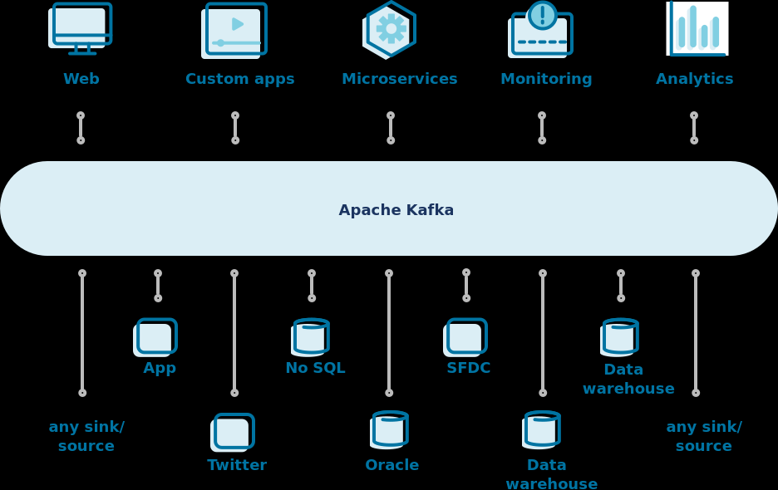
Where Apache Kafka fits in

Slide 31
Overview of Pub/Sub in Python
Pypub/sub provides a simple way for your Python application to decouple its components: parts of your application can publish messages (with or without data), and others can subscribe/receive them. This allows message "senders" and message "listeners" to be unaware of each other:
one doesn't need to import the other
a sender doesn't need to know
"who" gets the messages,
what the listeners will do with the data,
or even if any listener will get the message data.
similarly, listeners don't need to worry about where messages come from.
This is an excellent tool for implementing a Model-View-Controller architecture or any similar architecture that promotes the decoupling of its components.

Slide 32
Introduction to Python
http://www.cs.unc.edu/~lin/COMP089H/PAPERS/Intro2Python.pdf
Automate your workflow from idea to production
https://github.com/GoogleCloudPlatform/cloud-pubsub-samples-python/actions

Slide 33
Streaming Data Pipeline using Google Cloud Platform
Windowing functions divide unbounded collections into logical components or windows.
Windowing functions group unbounded collections by the timestamps of the individual elements.
Each window contains a finite number of elements.
You set the following windows with the Apache Beam SDK or Dataflow SQL streaming extensions:
1. Tumbling windows (called fixed windows in Apache Beam)
2. Hopping windows (called sliding windows in Apache Beam)
3. Session windows

Slide 34
Spark Streaming Programming
Spark Streaming is an extension of the core Spark API that enables scalable, high-throughput, fault-tolerant stream processing of live data streams.
Data can be ingested from many sources like Kafka, Kinesis, or TCP sockets, and can be processed using complex algorithms expressed with high-level functions like map, reduce, join, and window.
Finally, processed data can be pushed out to filesystems, databases, and live dashboards. You can apply Spark’s machine learning and graph processing algorithms to data streams.

Slide 35
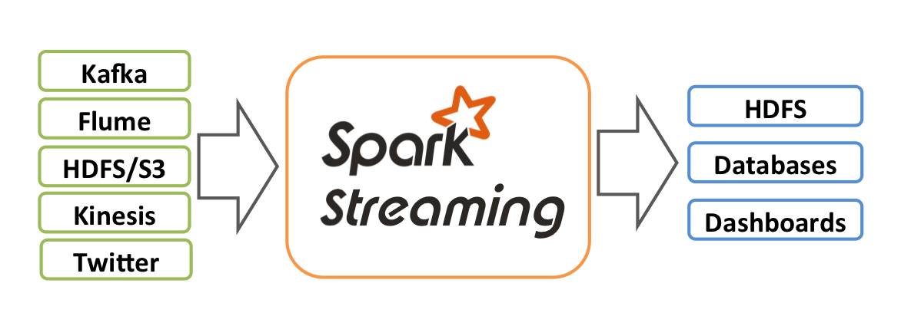

Slide 36
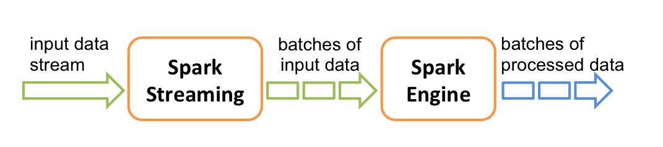
Spark Streaming Programming
Internally, it works as follows. Spark Streaming receives live input data streams and divides the data into batches, which are then processed by the Spark engine to generate the final stream of results in batches.

Slide 37

Spark Guide
https://spark.apache.org/docs/latest/streaming-programming-guide.html#spark-streaming-programming-guide

Slide 38
What is Streaming Data and Streaming data Architecture?
Streaming data refers to data that is continuously generated, usually in high volumes and at high velocity.
A streaming data source would typically consist of a stream of logs that record events as they happen – such as a user clicking on a link in a web page, or a sensor reporting the current temperature.

Slide 39
Common examples of streaming data include:
IoT sensors
Server and security logs
Real-time advertising
Click-stream data from apps and websites

Slide 40
Streaming Data Architecture
A streaming data architecture is a framework of software components built to ingest and process large volumes of streaming data from multiple sources.
While traditional data solutions focused on writing and reading data in batches, a streaming data architecture consumes data immediately as it is generated, persists it to storage, and may include various additional components per use case – such as tools for real-time processing, data manipulation, and analytics.

Slide 41
Streaming Data Architecture
Streaming architectures need to be able to account for the unique characteristics of data streams, which tend to generate massive amounts of data (terabytes to petabytes) that it is at best semi-structured and requires significant pre-processing and ETL to become useful.
Stream processing is a complex challenge rarely solved with a single database or ETL tool – hence the need to ‘architect’ a solution consisting of multiple building blocks.
Part of the thinking behind Up solver is that many of these building blocks can be combined and replaced with declarative functions within the platform, and we will demonstrate how this approach manifests within each part of the streaming data supply chain.

